Slide 1
Ethics of Science Communication in Democracies
Heather Douglas
(Michigan State University)
@ The Institute for Science and Policy
December 6, 2023

Slide 2
Starting Points
Democracy is the best form of government available.
Pluralist publics with divergent conceptions of a good life
Open debate, recall essential
Science is the best source of empirical knowledge available.
Not a source of permanent truths
A human practice, a social practice
Importantly value-laden
Contested, legitimated power

Slide 3
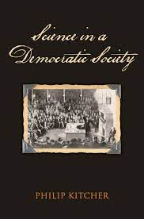
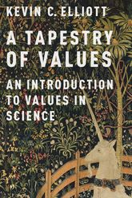
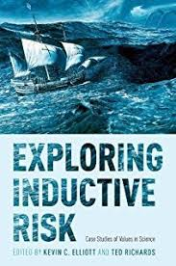
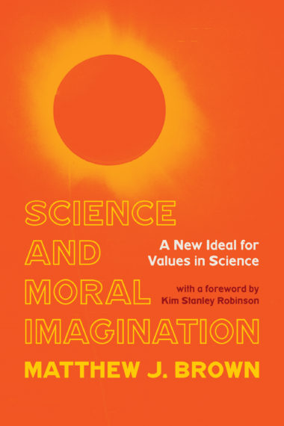
The Importance of Values in Science
(At least) two crucial places for social/ethical values in science:
Values direct the efforts of scientists, framing problems.
Are the right range of hypotheses/evidence being considered?
Is the framing of the problem good?
Values decide what counts as sufficient evidence.
How much uncertainty are we willing to accept?
Which errors are more important to avoid, false positives or false negatives?
Additional places:
Methods
Modeling decisions
Use decisions

Slide 4
Reliable science?
Scientific research is pursued within a community.
Critical
Open to all
Nondogmatic
Scientific claims are always revisable in principle.
Empirically based
New methods, evidence, theories possible
Ongoing uncertainty generates reliability

Slide 5
(Some) Goals of Science Communication in Democracies
Inform citizens of important scientific developments
Enable citizens to evaluate the decisions of their elected officials on science related policies
Encourage public support for science
Enable people to make scientifically informed decisions in their lives
Impart the wonder of the world
Foster a better understanding how science works

Slide 6
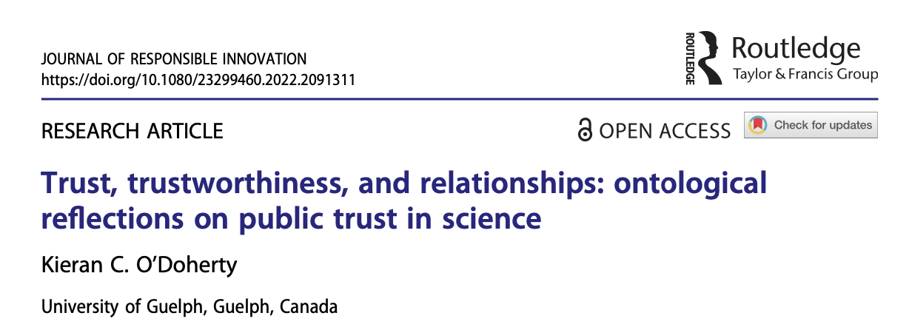
Trust and trustworthiness
Trust ≠ Reliance
Reliance can just be mechanical
Trust requires a belief in good will towards the trustor
Fostering trust could just be manipulative
One must also be trustworthy!
Not just inducing trust
Being deserving of trust

Slide 7
What makes science trustworthy?

Slide 8
(Some) Reasons for Distrust in Science
Scientific fraud
Failures to engage with criticisms and new approaches
Hype and overpromising
Commercialized science, bending science
History of minority abuse by scientists

Slide 9
Three Essential Bases for Trust in Science
Presence of Expertise
A Critical and Diverse Scientific Community
Shared Values

Slide 10
1. The Presence of Expertise
What is expertise?
Fluid judgment in the face of complexity
Within a particular domain
Developed within an expert community
Ability to ask the crucial questions
Know what works and what doesn’t
We are each experts in some domains and nonexperts in many (many) others.

Slide 11
A Spectrum of Expertise
Clear Success
Games
e.g.:
Chess masters
Go players
Professional athletes
Success with caveats
Car mechanics
Doctors
Dentists
Engineers
Strategists
Success murky
Climate modelers
Toxicologists
Epidemiologists
Economists

Slide 12
Assessing the Presence of Expertise
For clear success:
Is there success?
Particularly when compared to other experts!
Lacking clear success (confounded or otherwise):
Give key pieces of evidence, reasoning
Provide what has been ruled out and why
Explain judgments
Display fluency of expert judgment
Display depth of expertise

Slide 13
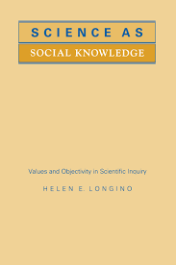
2. Critical and Diverse Scientific Community
Locations for debate, criticism, and discussion
Conferences
Journals
Online fora
Peer review norms
A culture that takes seriously critical debate
Expectation of both raising and responding to criticism
Open doors to all who want to join the community
Some training will be needed
Key for generating criticism and alternative approaches
Trustworthy experts MUST be engaged in such a community!

Slide 14
3. Shared Values
Shared values used in judgments are a crucial basis of trust.
Are the problems framed to include what I care about?
Are the methods sufficiently capable of capturing what I care about?
Is the evidence strong enough given my concern over risks of error?
We should trust the expert who makes judgments as we would, if we had their expertise.

Slide 15
Limits on Values in Science
Values should not:
Supplant evidence
Predetermine or bend research
E.g. picking a method that will guarantee a particular result
Be reasons to ignore criticisms
Inquiry must also be valued!
These limits should keep values from biasing science.
We should not just trust experts who say what we want to hear.

Slide 16
What about consensus?
Consensus
Disagreement
Must be a trustworthy consensus!
Properly formed
After good debate
Among trustworthy experts
Of a diverse community of experts
Your values should already be held by a member of the community.
Don’t prematurely generate the consensus.
Find the experts properly participating in the debate.
No inquirer facades!
Trust experts that share your values.

Slide 17
In sum
Three Bases for Trustworthy Science
Presence of Expertise
Engagement with a well-functioning scientific community
Shared values

Slide 18
Implications for Science Communication

Slide 19
What to communicate?
Communicating expertise
Communicating active debate
Communicating values

Slide 20
Communicating in Practice
Provide key evidence & reasons
In narrative form
Avoid probabilistic expressions (which pretend to more precision than exists)
Discuss what has been considered and set aside
Provide a window on the debate
If there are disagreements, explain them
Consensus is not required!! (But it can be useful...)
Share the values that shape the key judgments
Problem framing
Sufficiency assessments

Slide 21
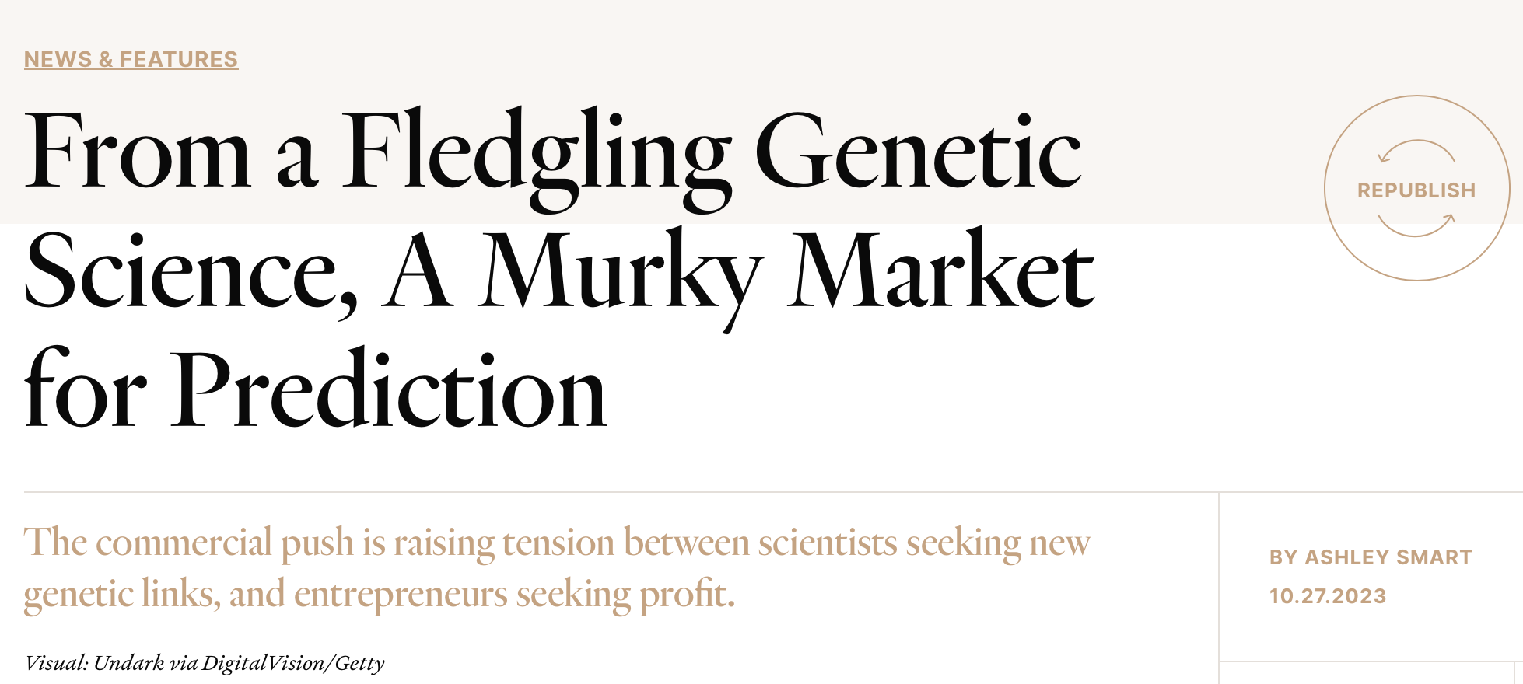
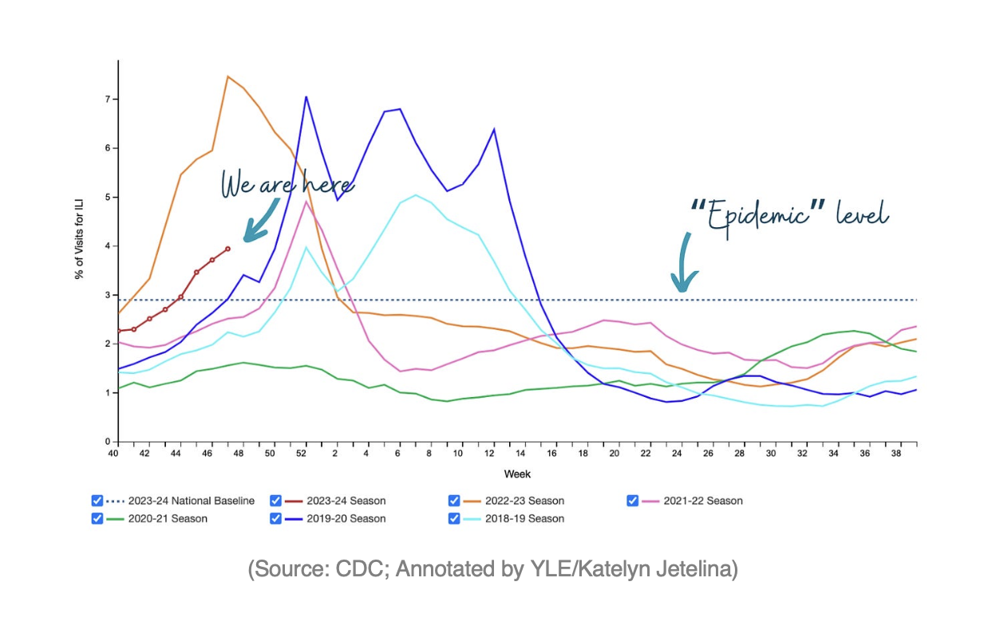
Examples

Slide 22
Ethics of Science Communication
Communicate those aspects of science that show trustworthiness
Presence of expertise
Functioning of expert community
Important values
Communicate also aspects that are not trustworthy!
Failures of science should be aired
Corrections to failures can build trust in the institutions of science
The public should trust only those aspects of science that are in fact trustworthy.

Slide 23
(Some) Goals of Science Communication in Democracies
Inform citizens of important scientific developments
Enable citizens to evaluate the decisions of their elected officials on science related policies
Encourage public support for science
Enable people to make scientifically informed decisions in their lives
Impart the wonder of the world
Foster a better understanding how science works

Slide 24
In Conclusion
Communicate guided by bases for trust in expertise:
Expert explanations and judgments
Debate in scientific community (past and current)
Values central to key judgments
Pluralist publics need diverse scientific communities
Shared values are essential to trust.
Particular science may not be univocal or universally trustworthy.
And we need to be okay with this.
Spaces for genuine interaction can help with all these issues.

Slide 25
Thanks!
Questions/comments?

